Slide 1
Using Kafka to integrate DWH and Cloud Based big data systems.
Mic Hussey, Confluent Nordics, mic@confluent.io

Slide 2
Event Streaming as a Foundational Technology
Foundational Technologies
Supporting Technologies
Innovation
Very few
Hundreds...

Slide 3






New Generation of Applications
Ubiquitous Internet Access
Fast
Always On
Mobile
Email
Web Browsing
Notes:
This new paradigm combined the best of both worlds to solve the problems we were facing.
[click for animation]
We could then do all the things we were used to doing on the desktop - which was mainly email and web browsing - but do it faster and on the go. That was valuable, but not nearly the end of the story.
[click for animation]
The true value of this paradigm shift was the new generation of applications that emerged.
[click for animation]
We could never imagine applications like Instagram, FaceTime or Skype without high-speed Internet access everywhere. And so we see that the emergence of these applications is what made ubiquitous internet access such an important, and business relevant, paradigm. Not just the fact that email, web browsing was available everywhere.
Now, coming back to our world of enterprise technology, a paradigm shift of similar magnitude and impact is happening in the area of enterprise applications and data.

Slide 4
ETL/Data Integration
Messaging
Batch
Expensive
Time Consuming
High Throughput
Durable
Persistent
Maintains Order
Fast (Low Latency)
Difficult to Scale
No Persistence
Data Loss
No Replay
Notes:
Right now, there are two models for data infrastructure. First is the ETL/Data Integration model, where organizations move large amounts of stored data to data warehouses, databases, and Hadoop for use in data analytics. This approach allows for high throughput data transfers, and is durable, persistent and maintains order. However, this approach also has major drawbacks. It is a batch transfer, is expensive, and is time consuming. Reports are generally available from this approach well after the data is generated. We often hear about reports being run at the end of the day --- and we ask, at the end of what day? The reality is, there is no end to the 24x7 business. It’s pretty clear that the ETL/data integration model is simply not a fit for running your business in anything close to real-time.
The other model is commonly known as messaging, and is meant to deliver data in real-time to applications. The advantage of this model is that it is fast, or low-latency. However, this model has significant drawbacks. It is difficult to scale for a high-throughput use case. Also, in this model, data is transient and does not persist. This is a big problem, because if something goes wrong, there no history to replay and fix it.
Both of these models have their inherent downsides, but the situation is actually even worse.

Slide 5


ETL/Data Integration
Messaging
Batch
Expensive
Time Consuming
High Throughput
Durable
Persistent
Maintains Order
Fast (Low Latency)
Difficult to Scale
No Persistence
Data Loss
No Replay
Notes:
This is what your applications and data infrastructure looks like.
You’ll see two big problems here.
First is the maze of point-to-point connections. Each of these is another potential integration to be developed and a potential point of failure. Even worse, as you move to microservices, the number of these point-to-point connections increases dramatically - making a bad scenario far worse.
The second problem is that these two systems don’t talk to each other. Therefore, it’s impossible to construct a view that spans across both your stored data as well as your real-time data. Every application you build essentially has one eye closed, as there is a whole other world of data it cannot access.

Slide 6
ETL/Data Integration
Messaging
Batch
Expensive
Time Consuming
High Throughput
Durable
Persistent
Maintains Order
Fast (Low Latency)
Difficult to Scale
No Persistence
Data Loss
No Replay
Stored records
Transient Messages
Notes:
Why do these problems exist? It’s because today, the world is trained to think of data as one of two things --- either stored records in a database, or transient messages from a messaging system.

Slide 7
Both of these are a complete mismatch to how a business works.
ETL/Data Integration
Messaging
Batch
Expensive
Time Consuming
High Throughput
Durable
Persistent
Maintains Order
Fast (Low Latency)
Difficult to Scale
No Persistence
Data Loss
No Replay
Stored records
Transient Messages
Notes:
Both of these are a complete mismatch to how you think about your business.
In the world of stored data, by the time you access and analyze stored data, it’s already out of date. This approach will never map with your business because your business is not best represented as a set of events that happened in the past.
The same, but opposite, logic applies to the world of messaging. Your business is not just a single message or data point that happens in a single moment. Without historical context, your message means nothing.

Slide 8
ETL/Data Integration
ETL/Data Integration
Messaging
Messaging
Event Streaming Paradigm
Messaging
Batch
Expensive
Time Consuming
High Throughput
Durable
Persistent
Maintains Order
High Throughput
Durable
Persistent
Maintains Order
Fast (Low Latency)
Fast (Low Latency)
Difficult to Scale
No Persistence
Data Loss
No Replay
Stored records
Transient Messages
Notes:
This is where Event Streaming comes in.
The Event Streaming paradigm recognizes that your business is the totality of all the events that are occurring now and that already occurred.
So what Event Streaming does is take the best aspects of these two different systems that are built for different purposes, and build from the ground up an entirely new modern technology platform.
In order to do accomplish something of this scale, we had to fundamentally rethink the notion of data itself.

Slide 9
Event Streaming Paradigm
Fast (Low Latency)
To rethink data as not stored records or transient messages, but instead as a continually updating stream of events
Notes:
What event streaming does is rethink data as not stored records or transient messages, but instead as a continually updating stream of events.
This stream needs to be readily accessible, fast enough to handle events as they occur, and able to store events that previously occurred.
It essentially is a never-ending stream of events that is stored and continually being updating.
It gives you a real-time view of your data but also maintains full history of how your data has changed.

Slide 10
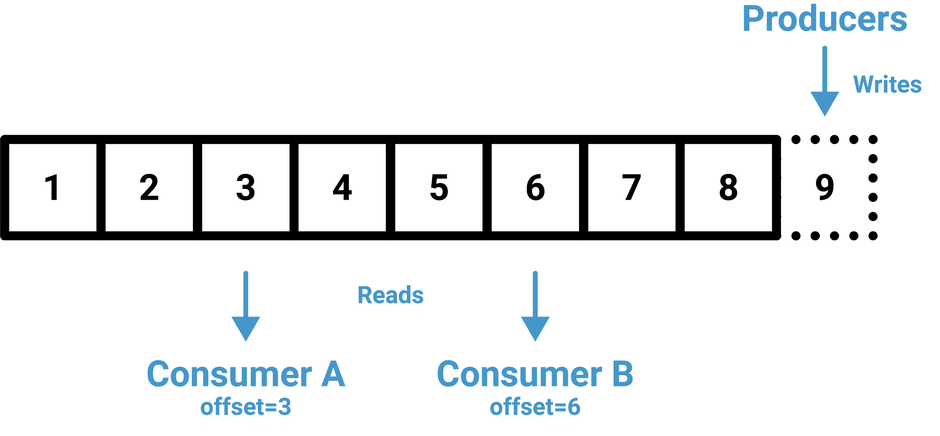
Event Streaming Paradigm
Fast (Low Latency)
Notes:
In tech terms, we call this a continuous commit log.
So what’s the business value of all this? Well, there are two distinct values and I’ll talk about them one by one.

Slide 11


Apache Kafka, the de-facto OSS standard for event streaming
Real-time | Uses disk structure for constant performance at Petabyte scale
In production at more than a third of the Fortune 500
2 trillion messages a day at LinkedIn
500 billion events a day (1.3 PB) at Netflix
Reliable | Replicates data, auto balances consumers upon failure
Scalable | Distributed, scales quickly and easily without downtime
Persistent | Persists messages on disks, enables intra-cluster replication

Slide 12
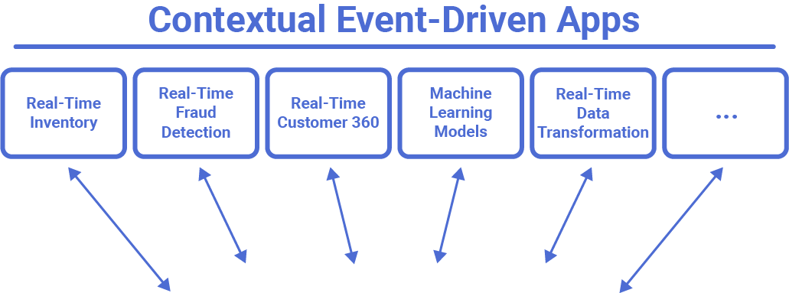

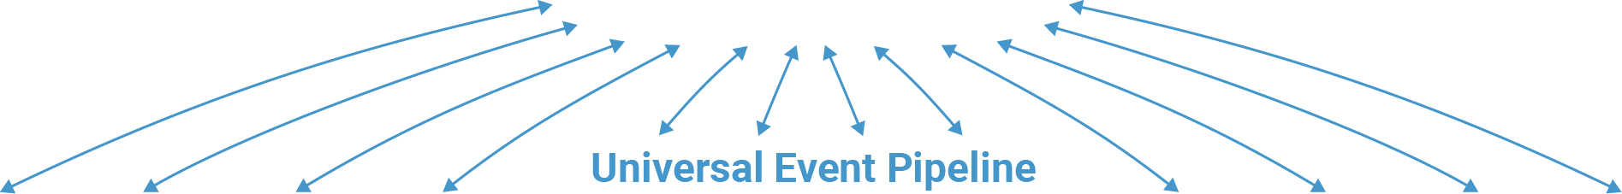
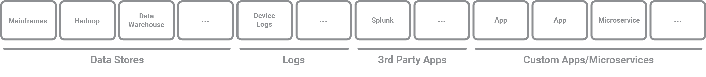
Notes:
Here is an open-source depiction of an Event Streaming platform with connecting systems. You’ll see the 4 central elements of Apache Kafka, which includes core Kafka, Clients, Kafka Connect, and Kafka Streams.
You’ll see how an event streaming platform sits at the center of your applications and data infrastructure, connecting to other systems such as Data Warehouse, Hadoop, or custom apps, 3rd party apps, as well as to your event-driven applications. For this reason, customers have referred to it as the Central Nervous System of their enterprise.
Lastly, it’s important to note that the diagram here represents what this looks like from an open source perspective. As you know, in order to succeed with any open source solution, there is a significant amount of work and custom development you as a customer would have to do.

Slide 13
Data Warehouses to Big Data

Slide 14
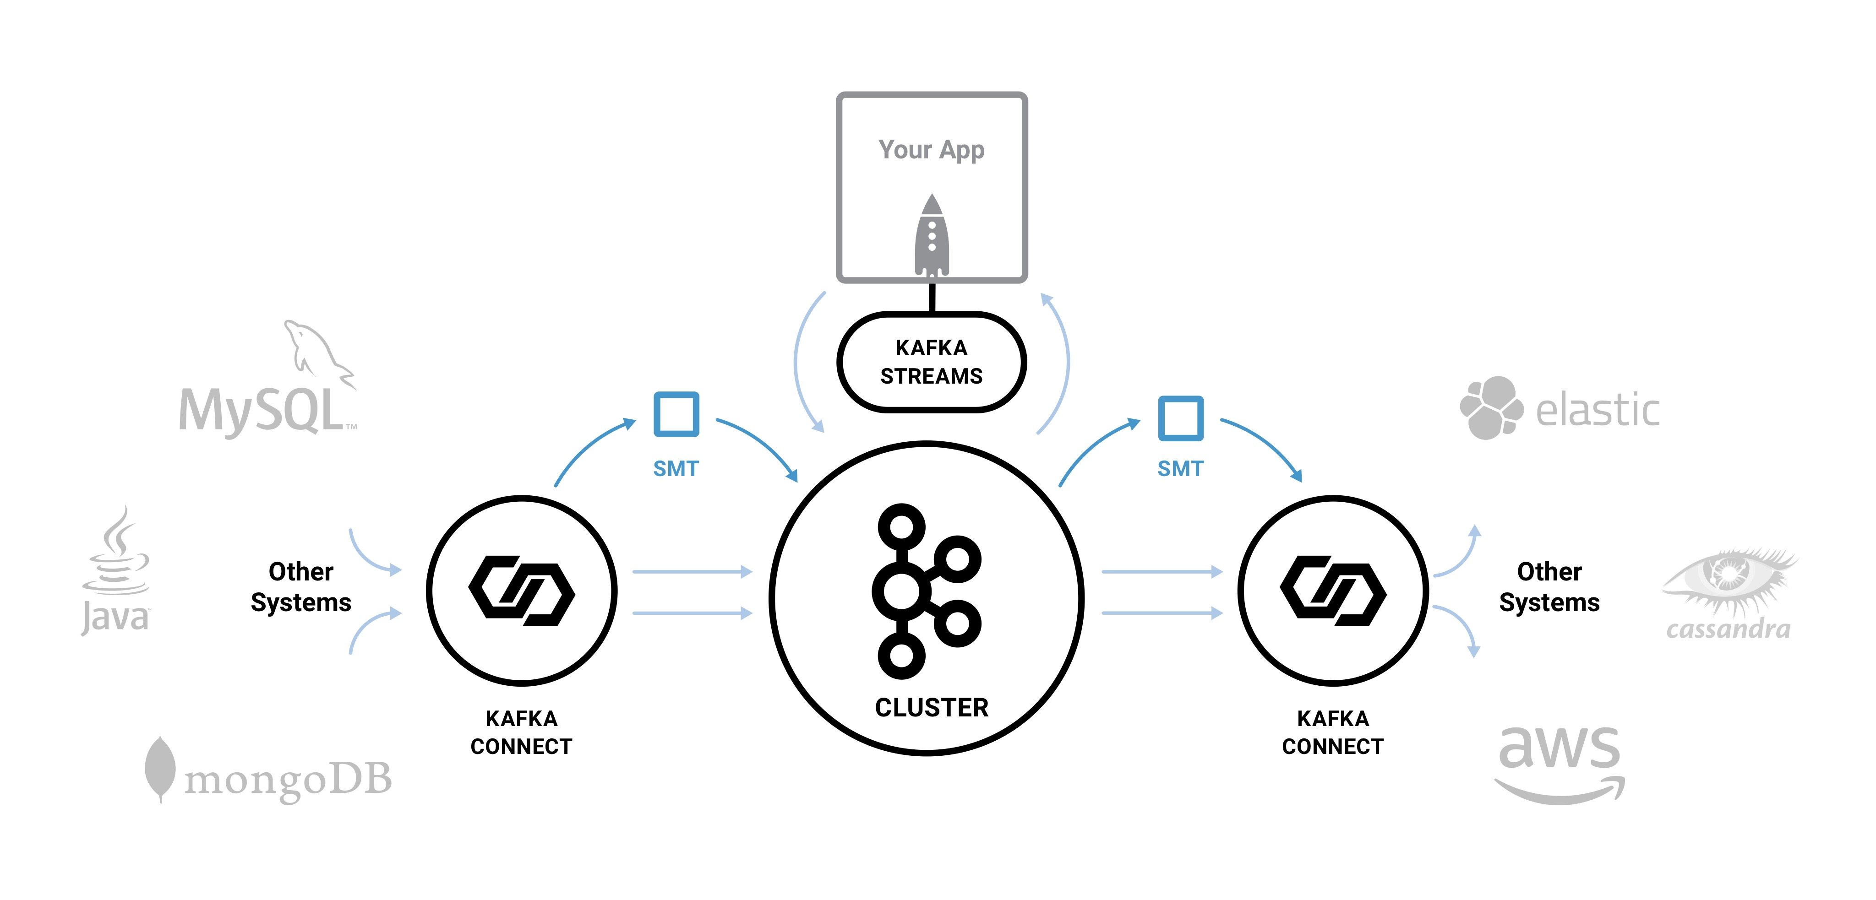
Kafka Integration Architecture
CONSUMER
PRODUCER

Slide 15
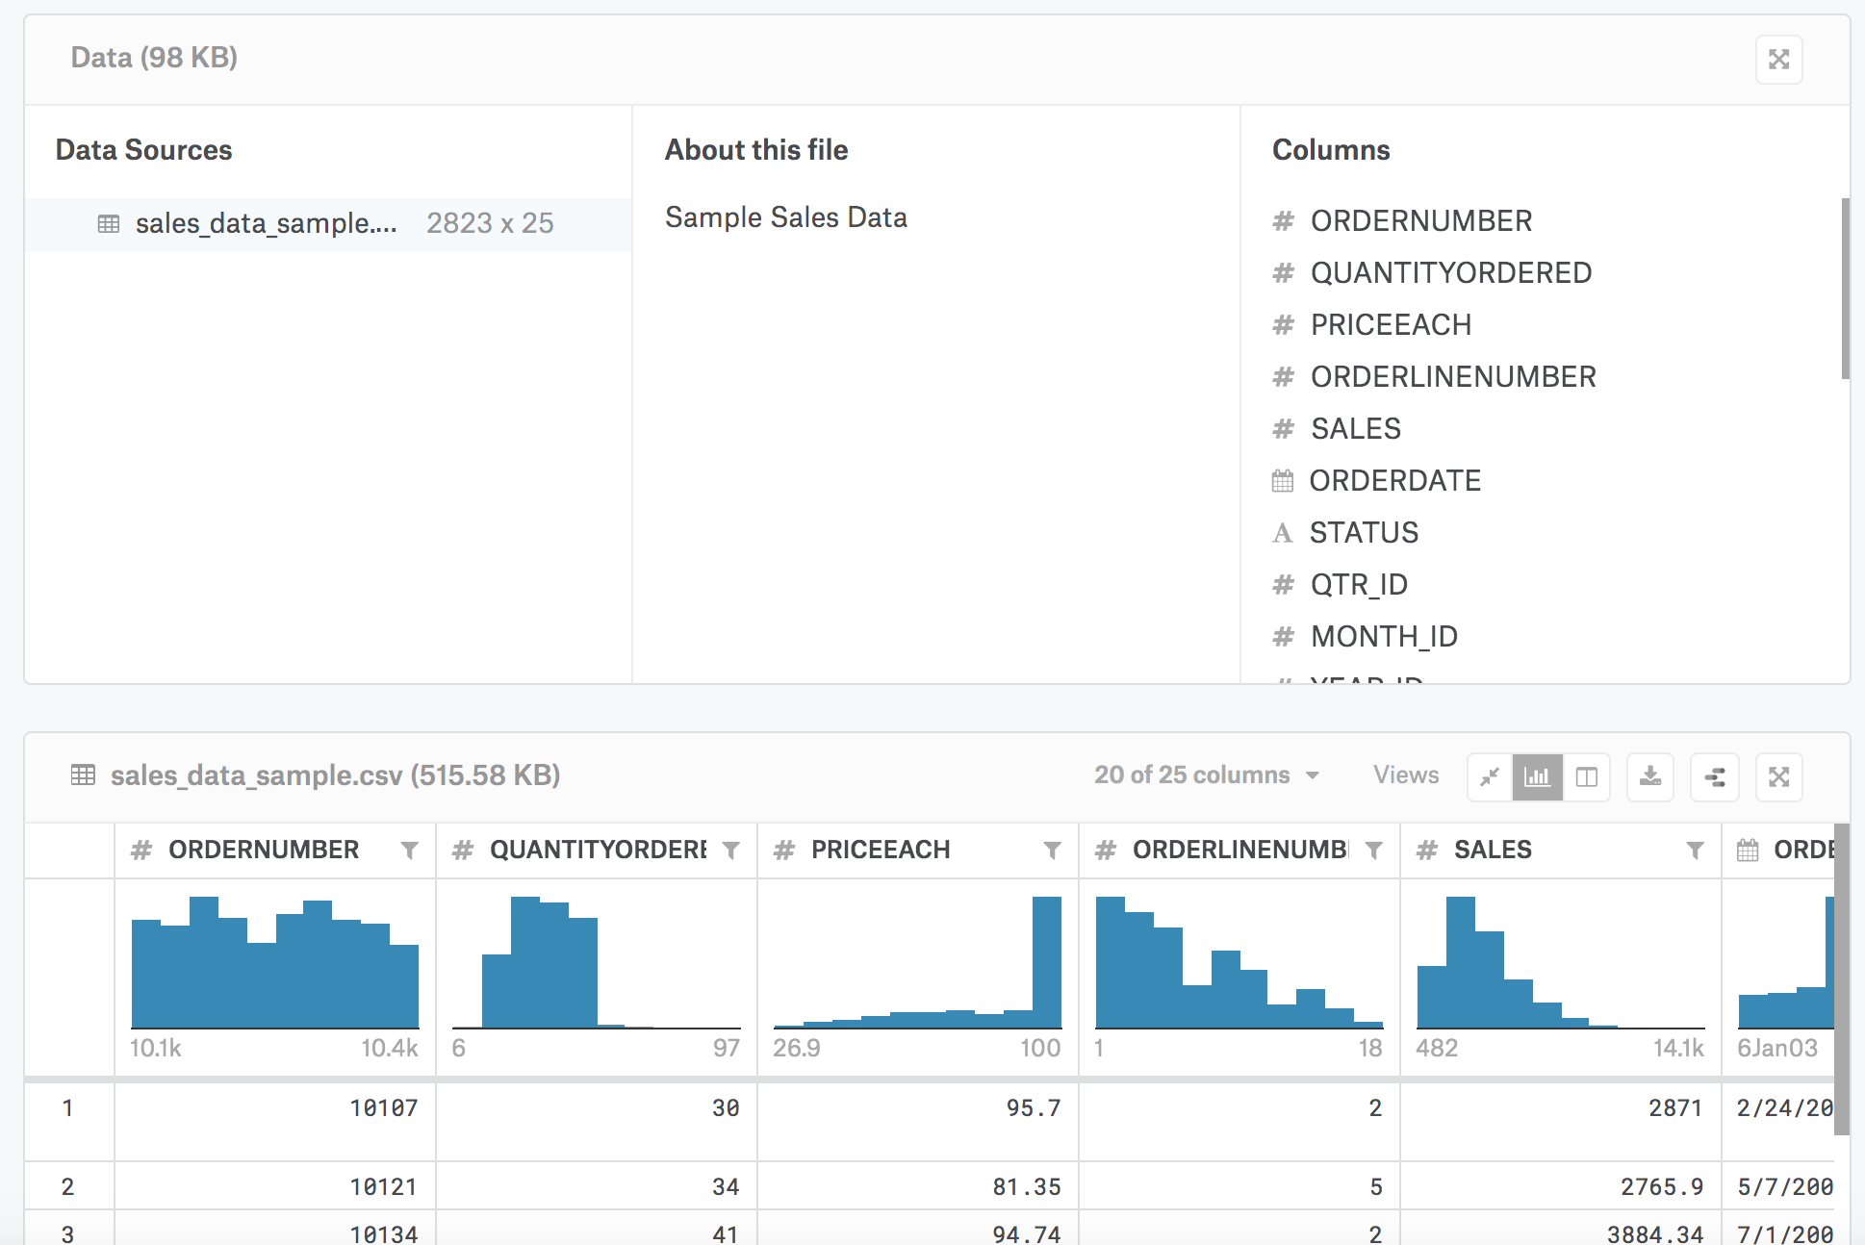
Sample UseCase: Sales data
Dataset from Kaggle https://www.kaggle.com/kyanyoga/sample-sales-data

Slide 16
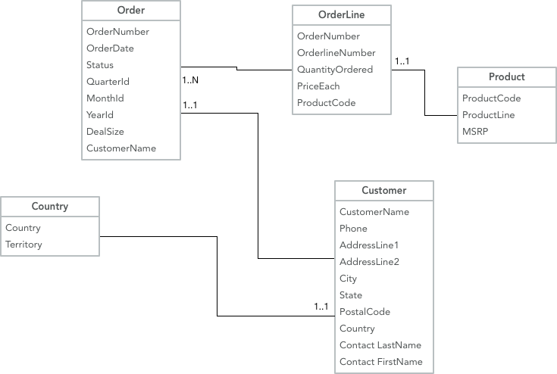
DWH
Current de-facto data integration technology
Third Normal Form
Minimises data duplication
Star schema

Slide 17
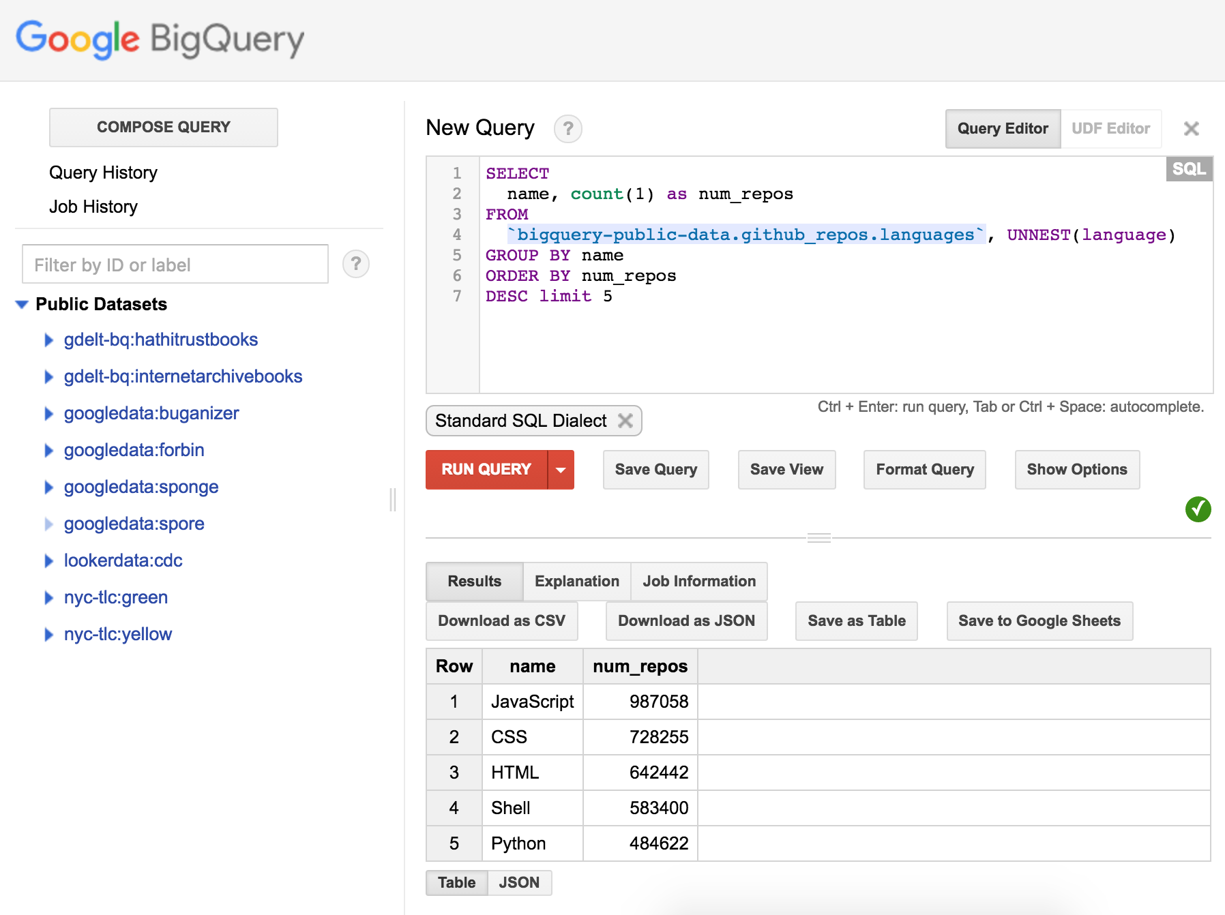
Big Data
Data storage is cheap
Tabular data
Flat schema

Slide 18
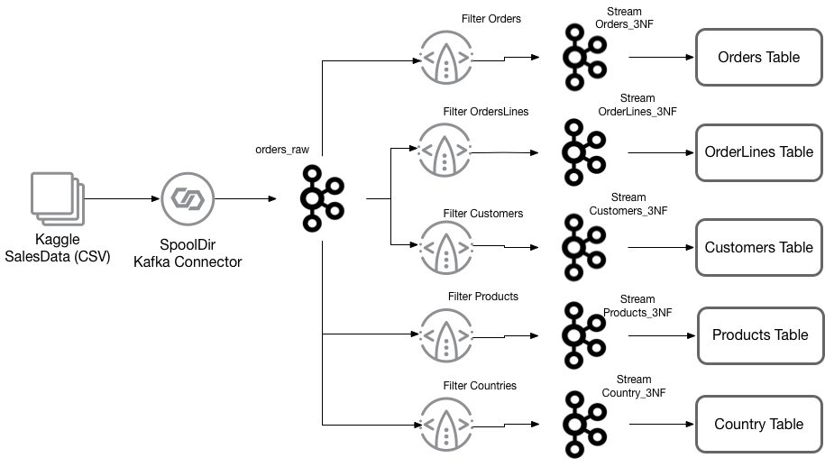
Demo Scenario

Slide 19
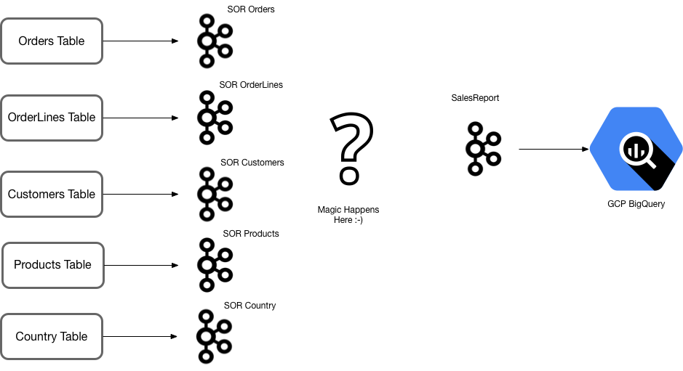
There’s a huge gap!

Slide 20
Stream Processing by Analogy
Connect API
Stream Processing
Connect API
$ cat < in.txt | grep “ksql” | tr a-z A-Z > out.txt
Kafka Cluster
Notes:
We’re going to be talking a lot today about Stream Processing, and how KSQL imakes it really easy to do for data flowing through your Kafka systems.
But before we dive into that, let’s take a quick moment to clarify, by means of an analogy, what we mean by Stream Processing in the first place.
I’m sure we’re all familiar with something like this, right ? When Unix pipes were invented by Douglas McIlroy, and added to Unix all the way back in 1973, they gave us this great new ability to stream the output of one shell command straight into the input of another.
In many ways pipes are analogs of how we use kafka topics in a modern data architecture – they transport data between discrete systems and processes. The difference of course is that kafka topics are not 1-1 channels but rather many-many. And of course they run in a distributed system at massive scale. But the analogy holds in this diagram we can think of the pipes as being the actual topics
<CLICK>
The redirect operators which feed data into the chain or sink it at the output end may be Kafka Connectors for mysql or hdfs or s3 or your own custom applications
<CLICK>
And the programs or operations which run on the data in-between the pipes are stream processors – they take a stream of input data and transform or filter it, then pass along their output to the next process. The distributed-systems verion of this idea is what we mean we talk about Stream Processing.

Slide 21

KSQL
is the
Streaming
SQL Engine
for
Apache Kafka
Notes:
Not only does a Streaming Platform power scalable messaging, but it also serves as the foundation for building Streaming Data Pipelines, Take Kafka’s Connect API for instance. Today you can build streaming data pipelines with a growing ecosystem of Kafka connectors to all sorts of systems. Kafka Connect does all the hard work, that every connector can then leverage. This platform-centric approach really simplifies data pipelines.

Slide 22
Stream processing with KSQL
CREATE STREAM oob_readings AS
SELECT *, c.std_value, c.sigma
FROM sensor_reading s
LEFT JOIN sensor_characteristics c
ON s.id = c.id
WHERE abs(s.value – c.std_value) > 3*c.sigma;
Simple SQL syntax for expressing reasoning along and across data streams.
You can write user-defined functions in Java
Notes:
This is one of the WesternElectric / ControlChart rules. Check to see if the current sensor reading is more than 3 standard deviations away from the mean.

Slide 23
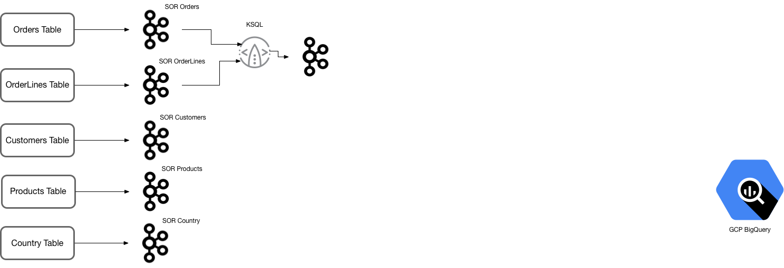
Streaming KSQL: pairwise joins

Slide 24
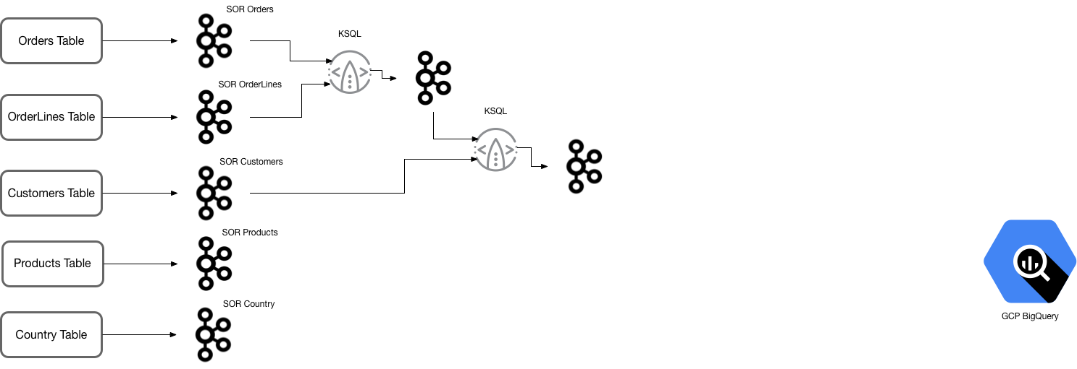
Streaming KSQL: pairwise joins

Slide 25
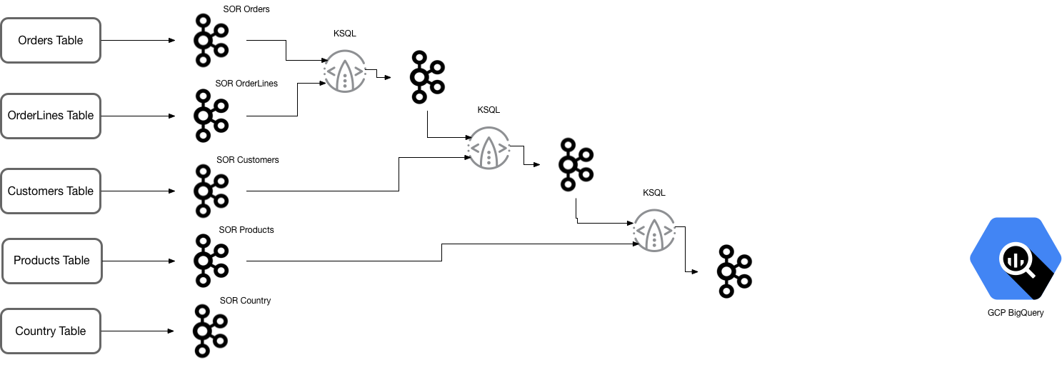
Streaming KSQL: pairwise joins

Slide 26
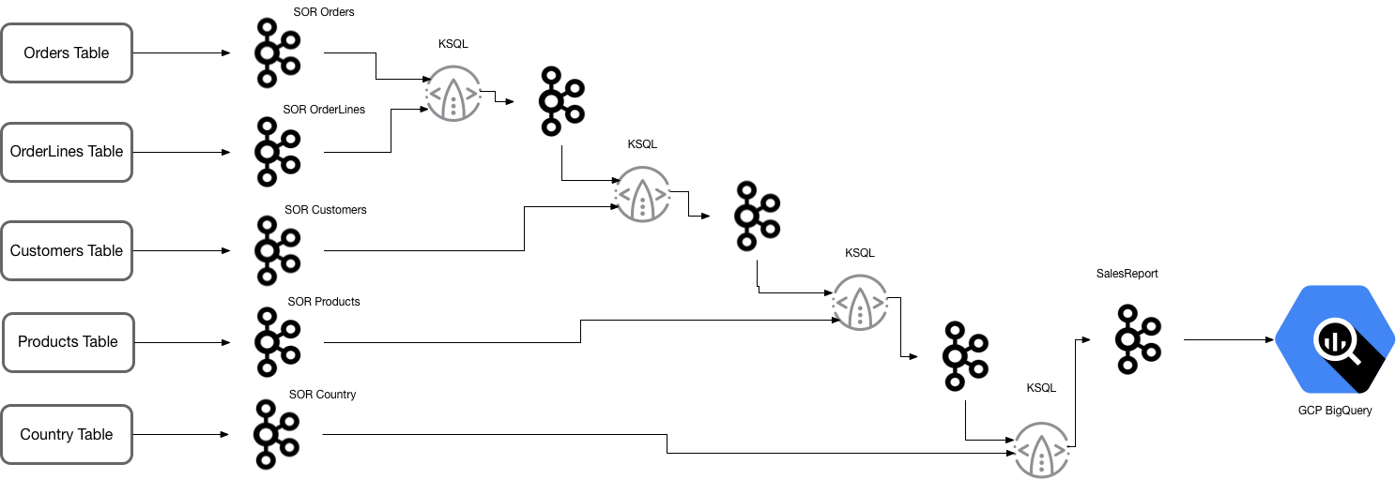
Streaming KSQL: pairwise joins

Slide 27
What does KSQL look like?
First load a topic into a stream
Then flatten to a table
Join stream to table for enrichment
CREATE STREAM ORDERS_3NF
WITH (KAFKA_TOPIC='orders_cdc', VALUE_FORMAT='AVRO’)
PARTITION BY ORDERNUMBER;
CREATE TABLE T_ORDERS_3NF
WITH (KAFKA_TOPIC='ORDERS_3NF', VALUE_FORMAT='AVRO', KEY='ORDERNUMBER’);
CREATE STREAM orderlines1 AS
SELECT ol.*, o.ORDERDATE, o.STATUS, o.QTR_ID, o.MONTH_ID, o.YEAR_ID,
o.DEALSIZE, o.CUSTOMERNAME
FROM ORDERLINES_3NF ol
LEFT JOIN T_ORDERS_3NF o ON ol.ORDERNUMBER = o.ORDERNUMBER;

Slide 28
Or use the Kafka Streams API
Java or Scala
Can do multiple joins in one operation
Provides an interactive query API which makes it possible to query the state store.

